Slide 1
ONLINE LEARNING PLATFORM
USING MERN
TEAM NUMBER: CSG98 TEAM MEMBERS:
CHICHILI TEJASWINI REDDY (211521104027) PARAVATHALA HARINI (211521104102) SANDRA CHAITHANYA(211521104134) TATIPARTHI SRAVANI(211521104169)

Slide 2
TABLE OF CONTENTS
ABSTRACT
INTRODUCTION
PROJECT OVERVIEW
IMPLEMENTATION:MERN STACK FRONTEND
BACKEND DATA DESIGN
BLOCK DIAGRAM
MODEL SCREENSHOT
CONCLUSION

Slide 3
ABSTRACT
The Online Learning Platform is a full-stack MERN (MongoDB, Express.js, React, Node.js) web application designed to provide a centralized platform for users to Learn courses in an efficient and secure manner. The platform streamlines learning by assigning courses to appropriate users, allowing real-time interaction, and sending automated notifications. Enhanced by features like user authentication, intelligent routing, and data security, this platform offers a robust solution for online learning and user satisfaction.

Slide 4
INTRODUCTION
This project aims to develop an online learning platform using the MERN stack—MongoDB, Express.js, React, and Node.js. Each component of the MERN stack contributes uniquely to the platform's functionality. MongoDB, a NoSQL database, ensures scalability and efficient management of vast amounts of data, while Node.js and Express.js together create a reliable backend for handling requests and managing data securely. React powers the frontend, providing a dynamic and responsive user interface that allows students and instructors to interact seamlessly with course content.

Slide 5
PROJECT OVERVIEW
Develop an interactive online learning platform using the MERN stack (MongoDB, Express.js, React, Node.js).
Implement secure user authentication and role-based access for students, instructors, and administrators.
Include features for course creation, management, and real-time progress tracking.
Integrate interactive tools like quizzes, assignments, discussion forums, and chat for active learning.
Ensure data security and privacy with HTTPS, token-based authentication, and GDPR compliance.
Design the platform to be modular and flexible for future enhancements like AI recommendations .

Slide 6
IMPLEMENTATION:MERN STACK FRONTEND
Material UI/Bootstrap: Used for styling to ensure a smooth, user-friendly experience across different devices.
Axios : Employed to handle HTTP requests between the frontend and backend, facilitating seamless communication with the server.
Real-Time Updates: Socket.io is integrated for real-time communication, enabling instant notifications and status updates for users.

Slide 7
BACKEND
Server-Side Logic: Handled by Express.js, managing routes and APIs for complaint submission, user authentication, and complaint management.
MongoDB: A NoSQL database used for storing user profiles, complaint details, and tracking information. MongoDB Atlas is leveraged for cloud storage and easy scalability.
APIs: RESTful APIs are developed to manage data flow between the frontend and backend, supporting CRUD operations (Create, Read, Update, Delete) for complaints and user interactions.

Slide 8
DATA DESIGN WITH MongoDB
Frontend-Backend Communication: Axios is used on the frontend to send API requests to the backend, which is handled by Express.js. This enables seamless data exchange for functionalities like AI agent-user communication.
Data Modeling:
MongoDB schema design for users, courses, content, and more
Data validation and sanitization
Server-Side Rendering (SSR) or Static Site Generation (SSG) (Optional):
Benefits and trade-offs
Implementation with Next.js Features: Socket.io enables real-time interaction between users and agents, facilitating instant chat and complaint updates, while WebRTC could be added for voice/video communication.

Slide 9
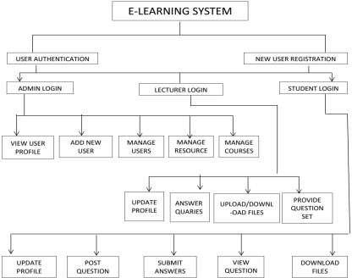
BLOCK DIAGRAM

Slide 10
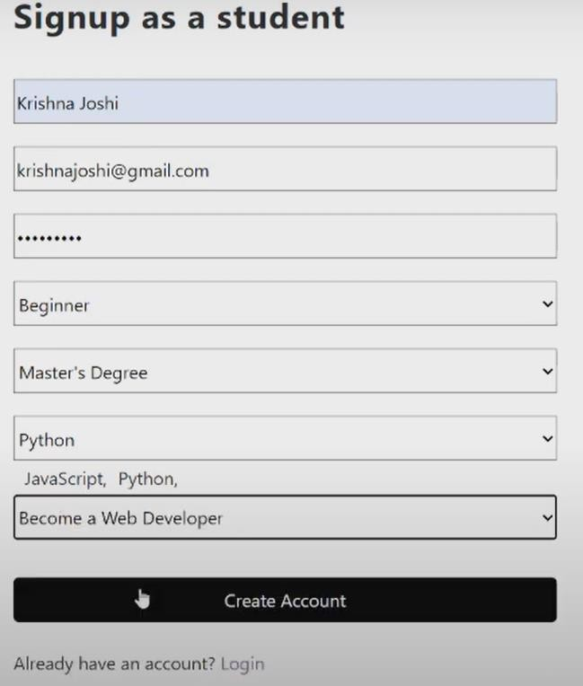
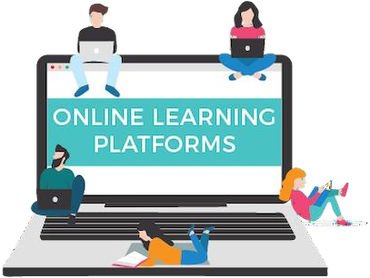
MODEL SCREENSHOT

Slide 11
CONCLUSION
The development of this online learning platform using the MERN stack has provided a robust, scalable solution for digital education that meets the diverse needs of students, instructors, and administrators. By integrating secure user authentication, comprehensive course management, interactive tools, and real-time progress tracking, the platform fosters an accessible and engaging learning environment. Its modular design allows for adaptability, ensuring that future enhancements like AI-driven recommendations and multilingual support can be seamlessly added to accommodate evolving educational trends. Overall, this MERN-based platform offers a user-centric, flexible, and secure solution that holds significant potential to enhance the online learning experience and support lifelong learning.

Slide 12
THANK YOU!

